Slide 1

Chatly: A Flutter and Firebase Project DISSERTATION Submitted in partial fulfillment of the Requirements for the award of the degree of Bachelor of Technology in Computer Science & Engineering
By: Under the guidance of:
Rishikesh Kumar(098/CSE2/2020) Ms. Amanpreet Kaur
Sahibpreet Singh(102/CSE2/2020)
Palak Midha(201/CSE2/2020)
Ishita Mahajan(202/CSE2/2020)
Department of Computer Science & Engineering
Guru Tegh Bahadur Institute of Technology
Guru Gobind Singh Indraprastha University
Dwarka, New Delhi
Year 2023-2024

Slide 2
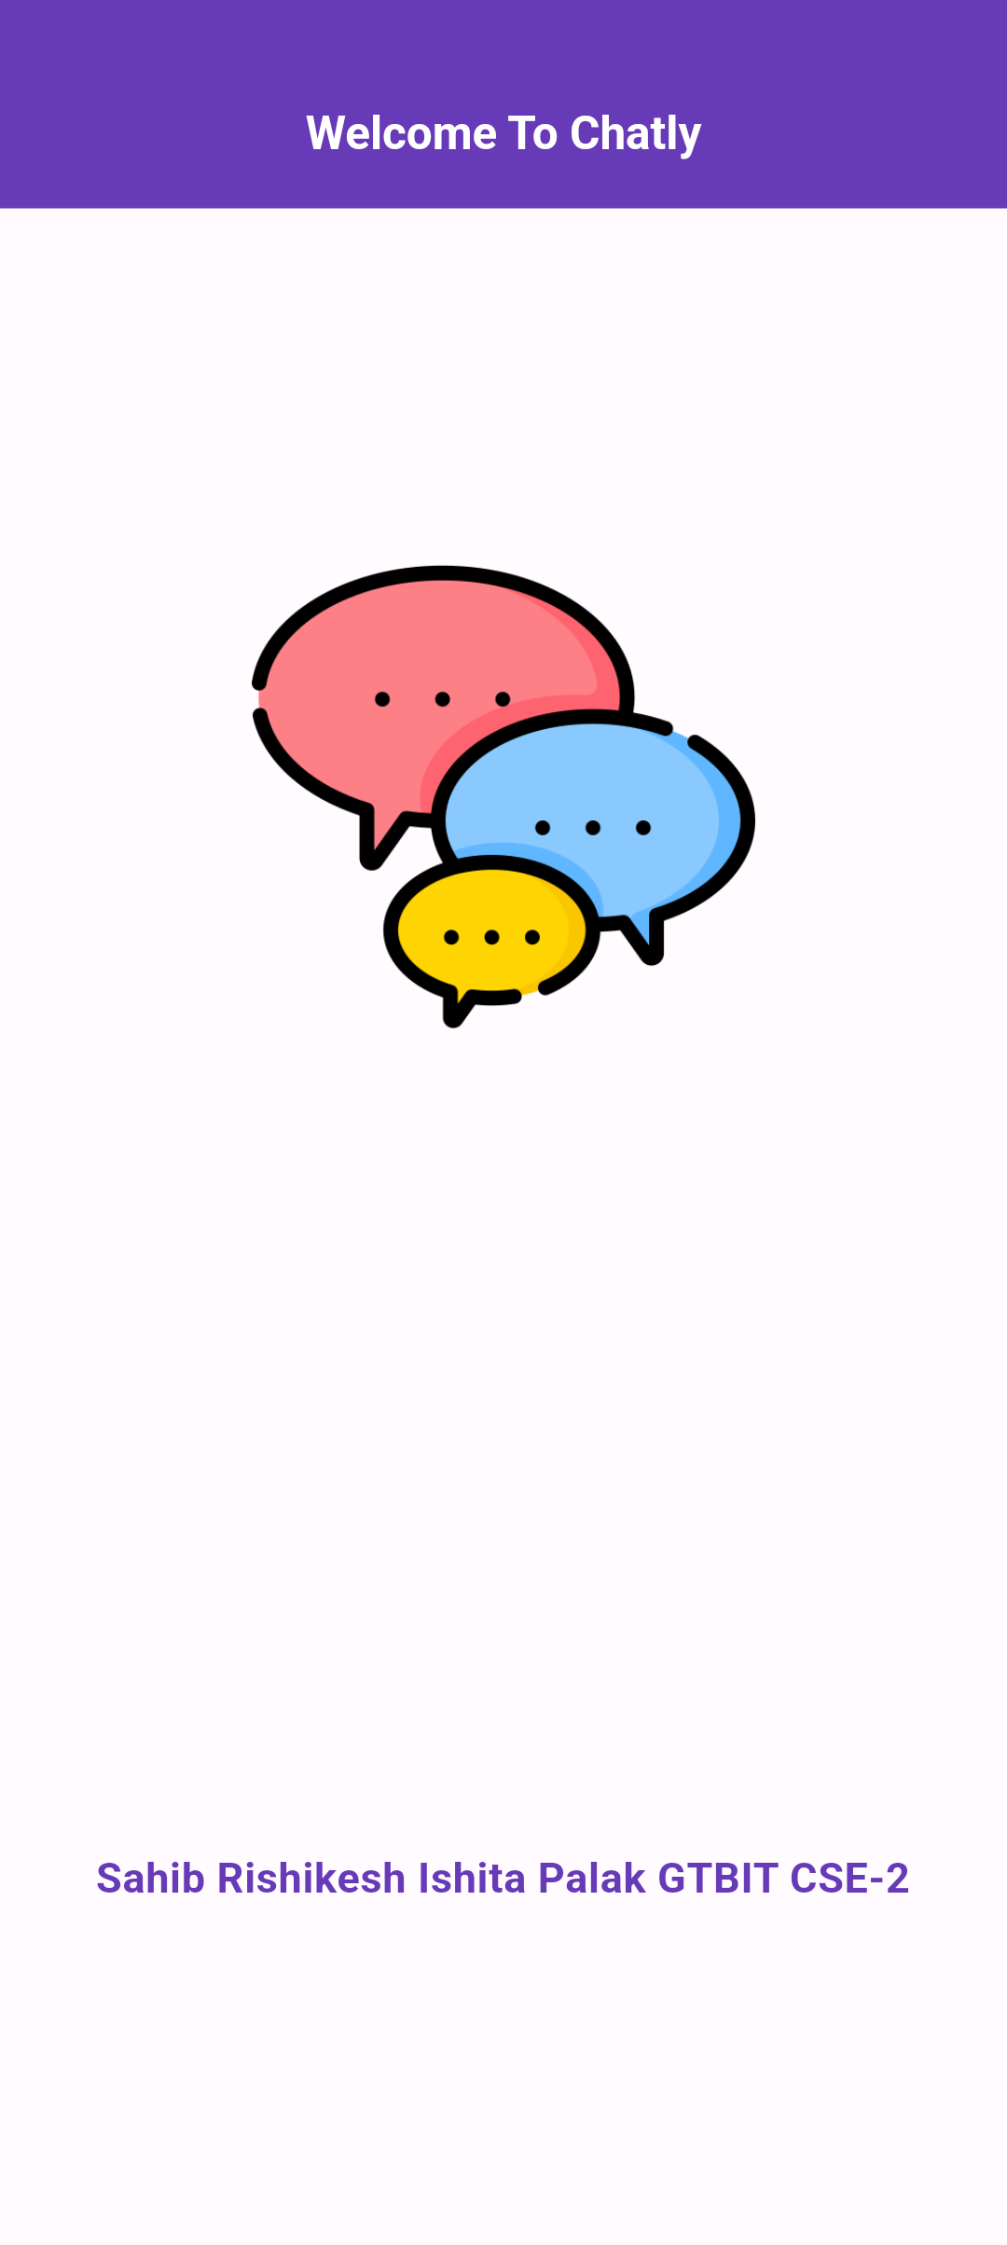
INTRODUCTION
The primary objective of this project is to design and implement a chat application comprising both server and user components, facilitating seamless communication among users.
An instant messaging solution is developed to ensure users can communicate in real-time, enhancing connectivity and collaboration.
We have leveraged modern technologies and coding languages such as Flutter and Firebase, the application is poised to incorporate cutting-edge features and ensure a robust and contemporary development framework.

Slide 3
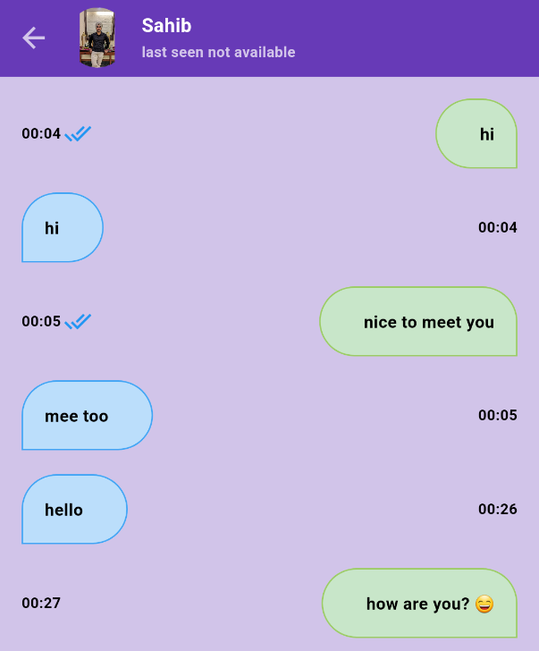
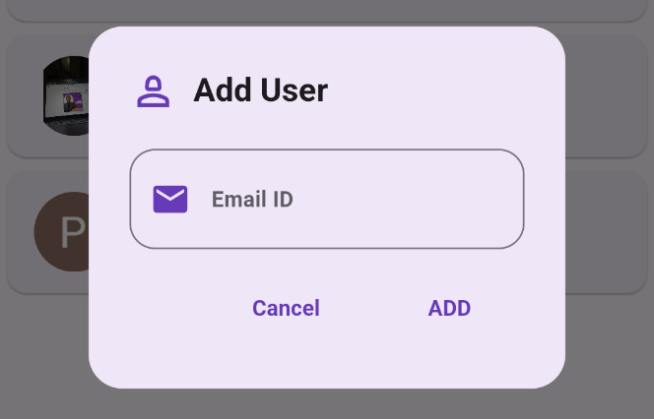
FEATURES
Chatting:
Testing the core one-on-one chat functionality, ensuring messages are sent and received accurately and in real-time.
Add Friend:
Verification of the process of adding new friends to the user's contact list.

Slide 4
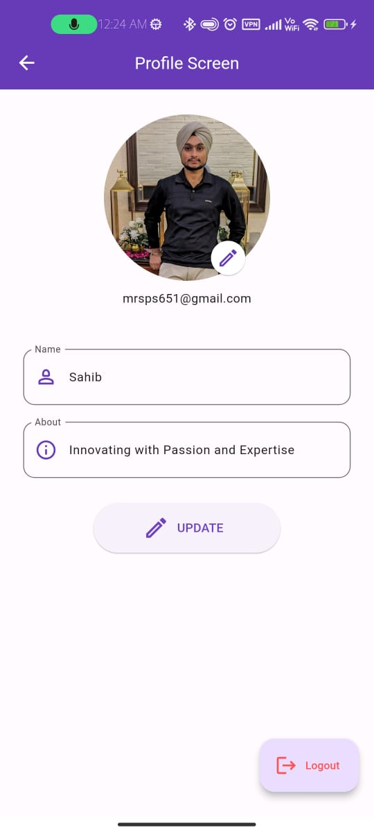
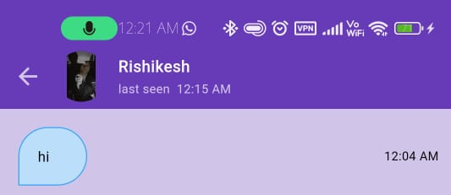
FEATURES
User Profile:
Thorough testing of user profile creation, editing, and viewing functionalities.
Last Seen:
Testing the functionality to be able to see the other user’s last seen and last online status.

Slide 5
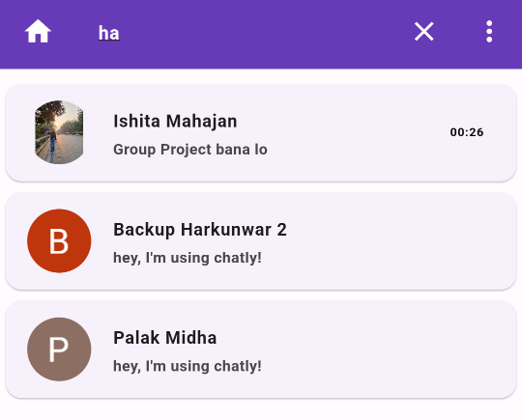
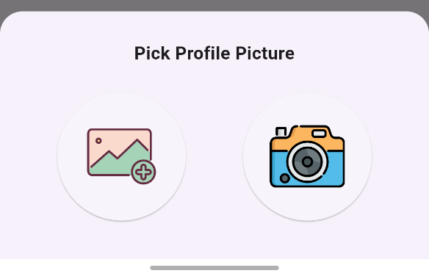
FEATURES
Search Friend:
Testing the functionality to search friends from the user's contact list.
Choose between Camera and Gallery:
Comprehensive testing of the feature allowing users to choose from the option of camera and gallery to upload onto the app.

Slide 6
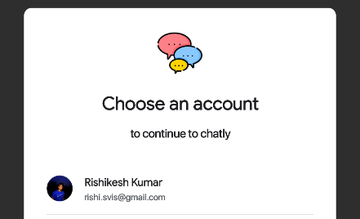
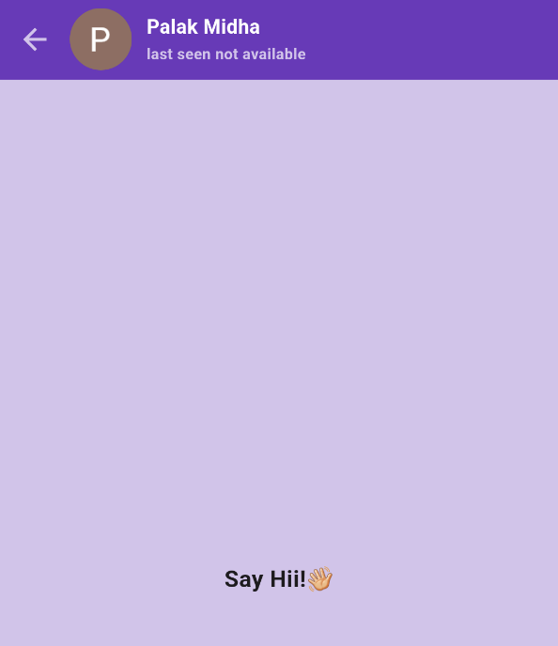
FEATURES
Registration:
Thorough testing of the user registration process, including data validation and account creation.
Start chat with a Friend:
Testing the prompts for a newly added contact where the application prompts the user to send the first message.

Slide 7
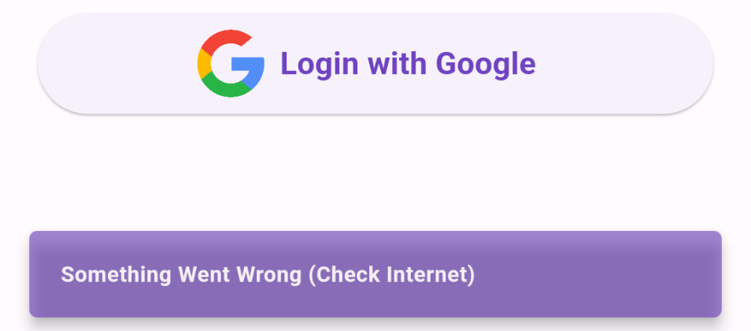
FEATURES
Log In:
Verification of the user login process, ensuring secure access to the application.
Log Out:
Testing the logout functionality to ensure a secure and seamless exit from the application.

Slide 8
REFERENCES
B. Smith, "Mobile App Development with Flutter," O'Reilly Media, 2020.
J. Doe et al., "Firebase Essentials for Flutter," Packt Publishing, 2019.
S. Johnson, "Flutter in Action," Manning Publications, 2021.
M. White, "Mastering Firebase for Flutter," Apress, 2022. A Clark, "Building Chat Applications with Flutter and Firebase," IEEE Transactions on Mobile Computing, 2020.
R. Gupta, "Flutter and Firebase: The Complete Guide," Udemy, 2021.
K. Patel, "Real-Time Mobile Application Development with Flutter and Firebase," International Journal of Computer Applications, 2019.
C. Williams, "Firebase for Flutter Developers," FlutterDev Monthly, 2022.
D. Brown, "Effective Flutter Development with Firebase," Addison-Wesley, 2020.
L. Johnson, "Chat Application Architecture: A Comprehensive Study," Journal of Software Engineering, 2021.
M. Davis, "Flutter Cookbook," O'Reilly Media, 2018.
S. Garcia, "Firebase Realtime Database: A Practical Guide," Pragmatic Bookshelf, 2019.
B. Anderson, "Flutter & Firebase: Build a Complete App for iOS & Android," LinkedIn Learning, 2021.
N. Smith, "Mobile App Development with Firebase and Flutter," Wiley, 2019.
P. Lee, "Building a Chat App with Flutter and Firebase," Flutter Community Magazine, 2022.
K. Harris, "Firebase for Flutter Developers: A Hands-On Guide," Springer, 2020.
T. Robinson, "Mastering Flutter: Advanced Techniques," O'Reilly Media, 2021.
Turner, "Real-Time Flutter Chat App: A Case Study," International Conference on Mobile Computing, 2018.
R. Martin, "Clean Architecture: A Craftsman's Guide to Software Structure and Design," Pearson, 2017.
J. Adams, "Firebase Cloud Messaging for Flutter," Google Developers, 2022.
C. Wilson, "Effective Firebase for Flutter Development," O'Reilly Media, 2019.
S. Miller, "Flutter Firebase Chat Application: A Step-by-Step Guide," Journal of Mobile App Development, 2020.
L. Thompson, "Flutter: A Quick Start Guide," Manning Publications, 2022.
M. Garcia, "Firebase Fundamentals," Google Developers, 2018.
D. Anderson, "Flutter and Firebase: Building Real-Time Apps," Packt Publishing, 2021.
Johnson, "Firebase Authentication in Flutter," Flutter Dev Weekly, 2019.
Patel, "Flutter and Firebase Integration: A Comprehensive Approach," Journal of Software Engineering Research and Development, 2021.
K. Hill, "Flutter: The Complete Guide to App Development," Apress, 2020.
L. Davis, "Firebase Functions for Flutter Developers," Google Developers, 2019.
P. Martinez, "Flutter Testing: A Comprehensive Guide," O'Reilly Media, 2022.

Slide 9
THANK YOU!

